Slide 1



TARGET DEMOGRAPHIC ANALYSIS

Slide 2
EXECUTIVE SUMMARY
OVERVIEW OF FINDINGS
Target Demographic: Men and Women ages 25 to 35
San Francisco: More male users (18,543) than female users (12,521) in San Francisco
Buying Power: Male users in the 25 to 34 age bracket have the most buying power followed by women ages 25 to 34
METHODOLOGY OF ANALYSIS
One main dataframe, DF, was created containing all data and values with a little over 61 thousand entries. Once the data was pulled into one main data frame it was then subsetted into two data frames for comparative analysis.
Subset1 excludes all null values, outliers, and -1 values for income. This reduced our data frame to roughly 10 thousand entries. DF1 excludes all outliers and -1 values for income leaving a little over 58 thousand entries.
Comparative statistical analysis was performed on both data sets to ensure integrity and consistency of findings.

Slide 3
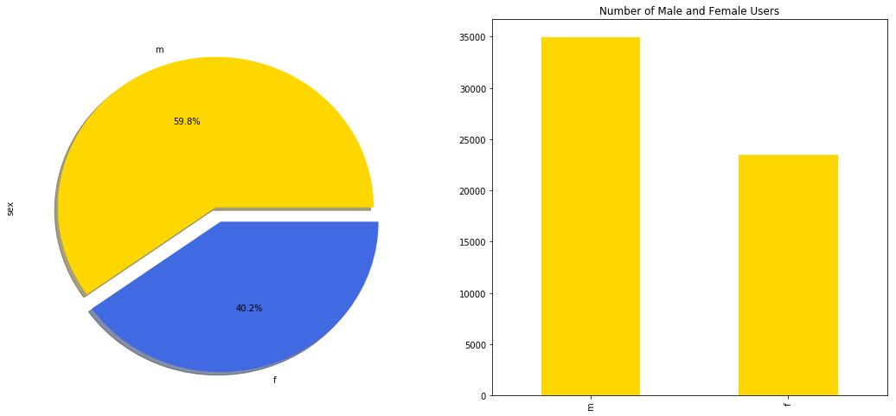
THERE ARE MORE MALE USERS

Slide 4
MALE USERS MAKE MORE MONEY
INCOME | FEMALE USERS | MALE USERS
-1 | 20564 | 27107
$20,000 | 1025 | 1910
$30,000 | 310 | 720
$40,000 | 329 | 656
$50,000 | 301 | 648
$60,000 | 207 | 510
$70,000 | 158 | 535
$80,000 | 249 | 830
$100,000 | 247 | 1340
$150,000 | 71 | 546
$250,000 | 5 | 43
A crosstab table of income levels between male and female users shows that men make more overall.

Slide 5
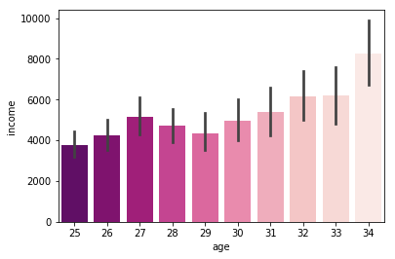
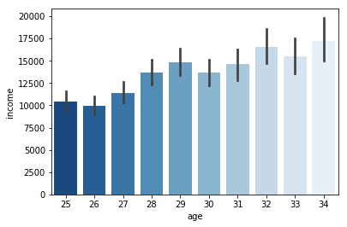
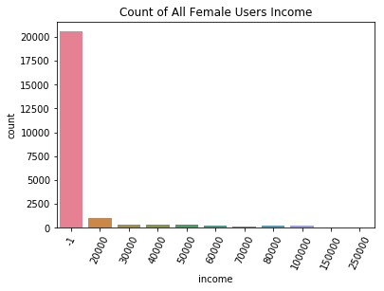
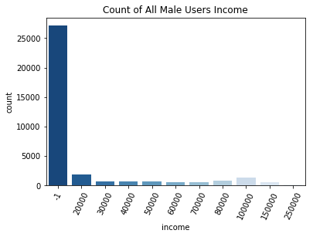
MEN MAKE MORE IN THE TARGET DEMO
A comparison of all female and male users to male and female users ages 25 to 34 find that men still make more than women

Slide 6
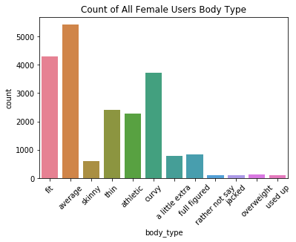
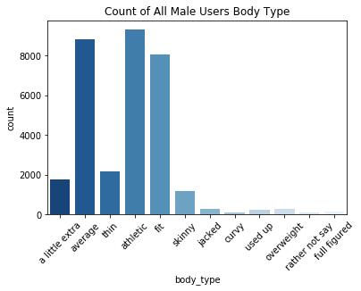
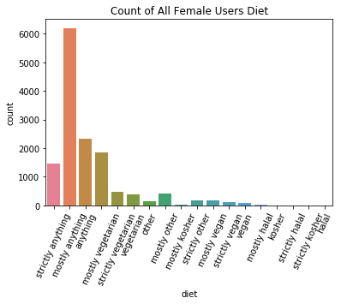
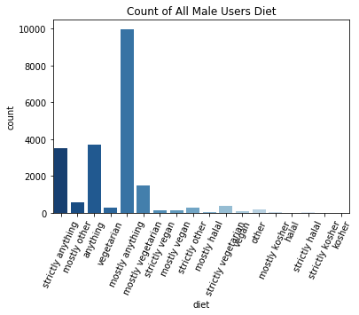
A LOT OF MEN THINK THEY’RE “ATHLETIC”
Despite similarities in dietary habits men consistently ranked their body types more favorably than women listing “athletic” and “fit” the most

Slide 7
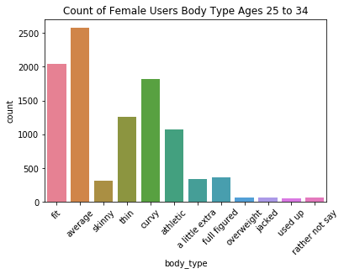
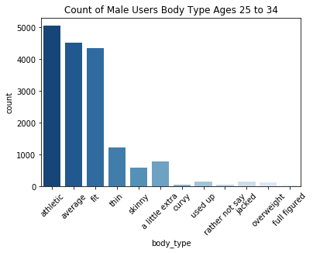
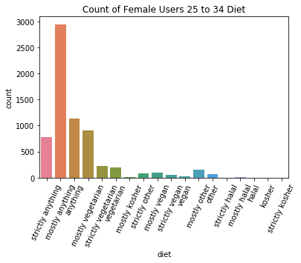
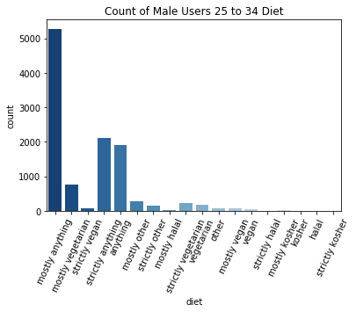
MEN IN TARGET DEMO THINK THE SAME
Initial findings in differences between reported dietary habits and body type between men and women remains the same for target demographic

Slide 8
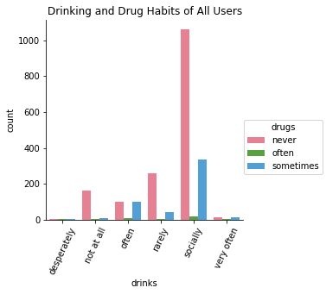
OTHER USER HABITS
Education
Users are likely to be college grads
Pets
Users like both cats and dogs
Offspring
Users are likely to be childless
Ethnicity & Orientation
Users likely to be white and straight
Religion
Users likely to be agnostic

Slide 9














Jenna
Works in Other/Education
KEY DEMOGRAPHIC
Age 25-34
College educated
White
Childless
Pet Friendly
Social drinker
No drugs
Not religious
Mean Income $5,130
CITY FACT:
San Francisco women are 12.50% more likely to reply
San Francisco
29, STRAIGHT
IMPORTANT: “Woke”, socially/politically aware,faithfulness, liberal attitude toward sex, not a commitment phobe
OTHER TRAITS: most likely to message older men first, competing with younger women but more confident than them, average body type, mostly eats anything

Slide 10
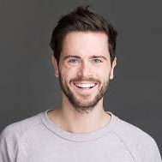

Chris
Works in Science/Tech/Engineering
KEY DEMOGRAPHIC
Age 25-34
College educated
White
Childless
Pet Friendly
Social drinker
No drugs
Not religious
Mean Income $13,346
CITY FACT:
San Francisco men are 33.33% more likely to reply
San Francisco
29, STRAIGHT
IMPORTANT: “Woke”, socially/politically aware, faithfulness, liberal attitude toward sex, not a commitment phobe
OTHER TRAITS: most likely to message younger women first, finds women less attractive as they get older, eats mostly anything and lists body type as “fit” or “athletic”

Slide 11
CONCLUSION
Given target audience age, socializing habits and social media usage, social media campaigns would be highly effective. Mixers or events at popular restaurants/bars/clubs is also suggested as well as popular events such as mud runs and activities that involve alcohol such as wine tastings or brewing classes.

